Slide 1
README: presentation breakdown
requirements: MUST NOT EXCEED 12MINS
[1MIN] Introduction, Overview business scenario, User scenarios, Assumptions
[3MIN] User scenario diagrams
[5MIN] Demonstration (& explanation)
[2.5MIN] Beyond the Scope (APIs)
^above are all required sections that must b covered during presentation!!!

Slide 2
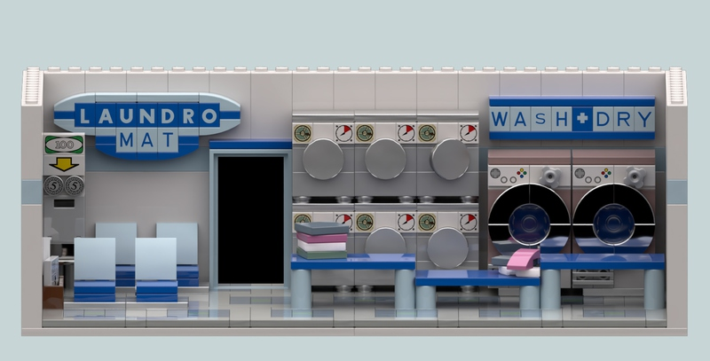





DE’Laundro Services
G4T4
Cha Da Eun, Daniel Tan,
Edward Puah, Inez Ho, Matthew Tan

Slide 3
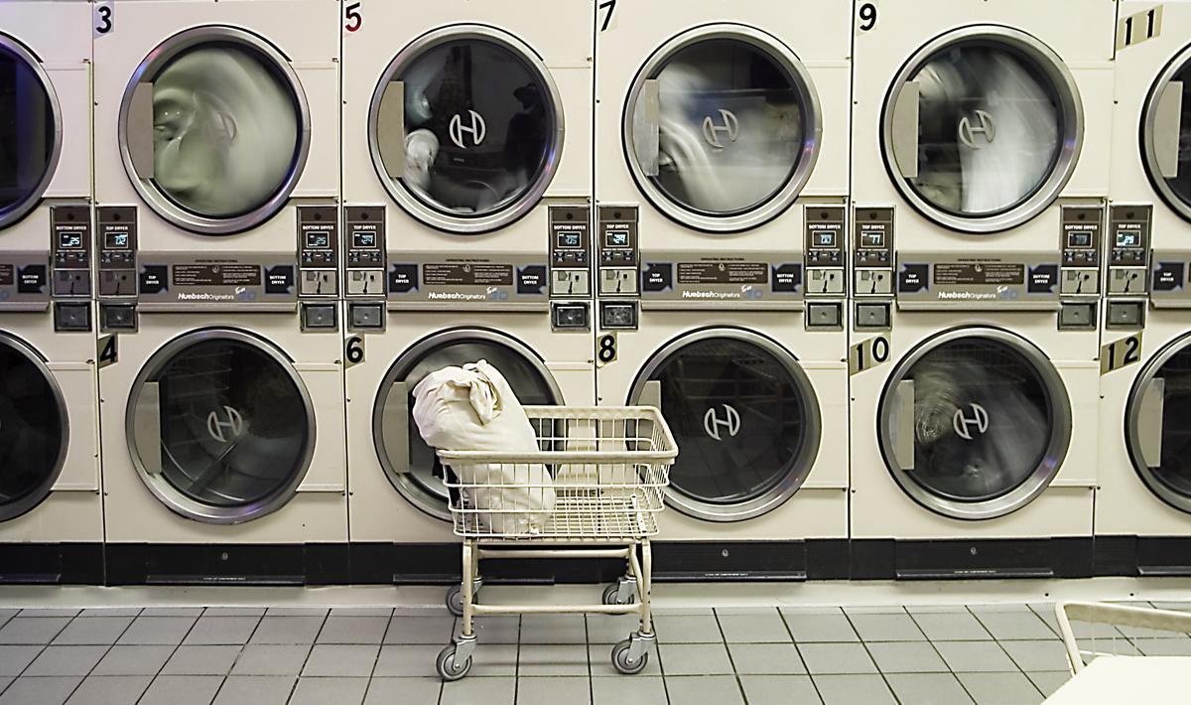
Overview Business Scenario
Entrepreneur Da Eun plans to open a self-service laundromat service in 3 locations: Balestier, Bukit Panjang and Novena. Each location has 6 machines and each machine has 3 types of wash - Standard, Double, Hot Water Normal Wash.
Da Eun plans to develop microservices to tackle:
Long waiting time for available machine at location
Hassle processing and waiting for successful payment
Slow staff response to machine errors

Slide 4
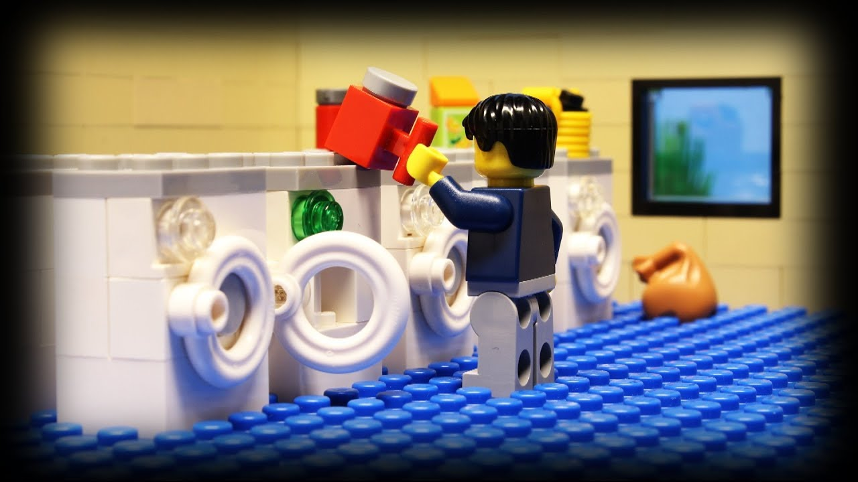
User
Scenarios
User requests for an available machine at selected location
After loading machine, user makes payment to start wash
Vendor monitor machine status
User receives an alert upon completion of wash

Slide 5
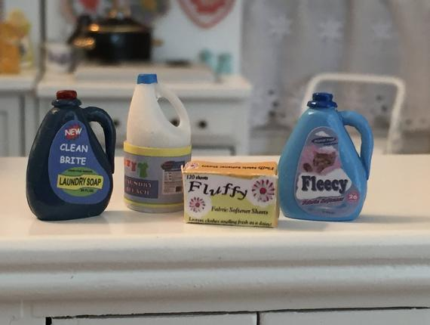
Assumptions
Vendor has an existing Google account.
Only 3 types of machine errors - Low level of detergent, machine is down, water is low.
User does not cancel services after joining the queue.
Each user joins one queue at any point in time.

Slide 6
User Scenario Diagram:
[1] User requests for an available washing machine
1. Get Machine ID
{Location}
5. Select Wash Type
{Wash Type}
Queue
2. Get list of available washing machines
{Location}
3. Return list of available washing machines
{Location, Machine IDs}
User UI
Send request for available washing machine
Selects Wash Type
HTTP GET
Status
4. Generate User ID and return Machine ID
{User ID, Location, Machine ID}
5. Sends matching information
{User ID, Location, Machine ID}
Legend
Monitoring
Micro-service
External service

Slide 7
User Scenario Diagram:
[2] User makes payment on application to start wash
Queue
1. Sends wash type {WashType}
3. Send payment details {Name, credit card number,...}
4. Send payment details {Name, credit card number,...}
User UI
Requests for payment amount
Makes Payment
HTTP GET
Payment
Stripe API
2. Return Price of Wash Type {Price}
7. Sends payment approval and displays QueueID for user
{QueueID, paid?}
5. Sends payment approval
{UserID, paid?}
6. Sends payment
{QueueID, MachineID}
Legend
Monitoring
Micro-service
External service

Slide 8
User Scenario Diagram:
[3] Vendor monitors machine status & make amendments if issues arise
Monitoring
User requests to current application logs
2. Send monitoring info
{ID, MachineID…,}
User requests to see current status of all machines
Status
Vendor UI
Monitor the condition of machines
Monitor the condition of the microservices
2. Send status info
{ID,MachineID…,}
Legend
Micro-service
External service

Slide 9
User Scenario Diagram:
[4] Users receives an alert upon completion of wash and collects laundry
User UI
Check laundry status
Provides alert if change in variable {done?} to TRUE.
1. Check for alerts {QueueID}
HTTP GET
Alert
5. Return laundry status information. If QueueID not found, done is FALSE
{QueueID, done?}
6. User updates collection details
{QueueID, collected?}
2. GET request is logged
{QueueID}
4. Sends list of finished QueueIDs
{QueueID,...}
3. GET Request for all finished QueueIDs
7. Update in collection details logged
{QueueID, collected?}
Legend
Status
Monitoring
Micro-service
External service

Slide 10
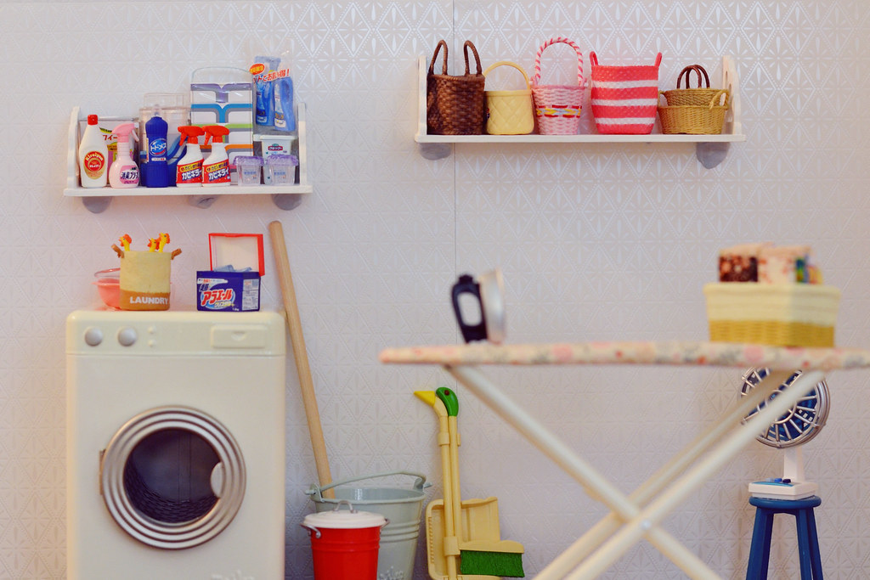
DEMONSTRATION

Slide 11
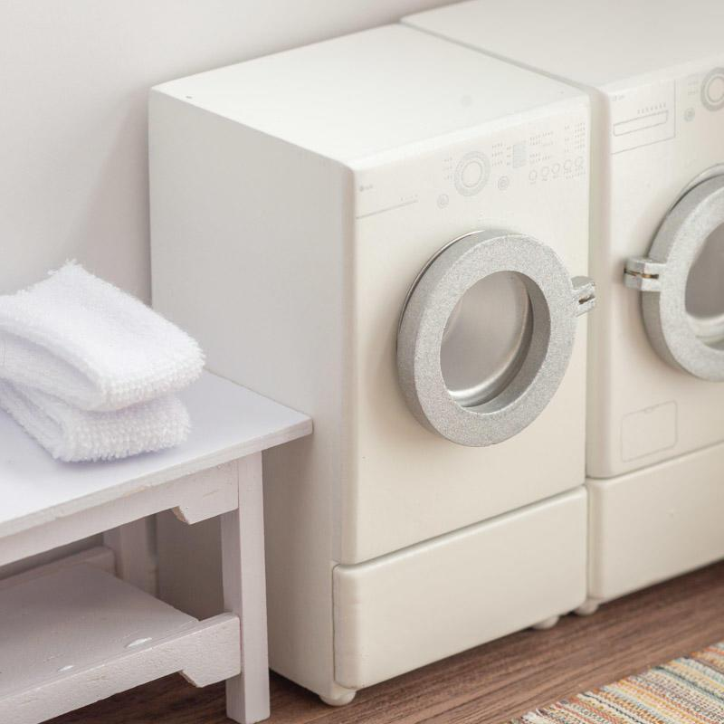
Machine Status Code
0: Available
1: Occupied
2: Machine Down

Slide 12
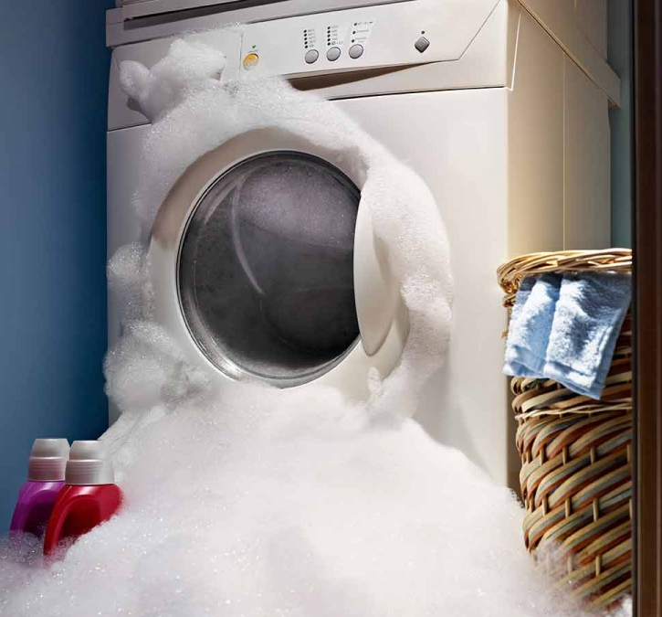
Machine Error Code
0: None
1: Low on Detergent
2: Machine is Down
3: Water is Low
Else: Error Unknown (Call Tier 3 Support)

Slide 13

Beyond the Scope
Telegram GUI

Slide 14

Beyond the Scope
Google Sign-In API

Slide 15

Beyond the Scope
Mailgun API

Slide 16

Beyond the Scope
Stripe API

Slide 17

Beyond the Scope
Docker Compose

Slide 18

Beyond the Scope
QR Server API

Slide 19
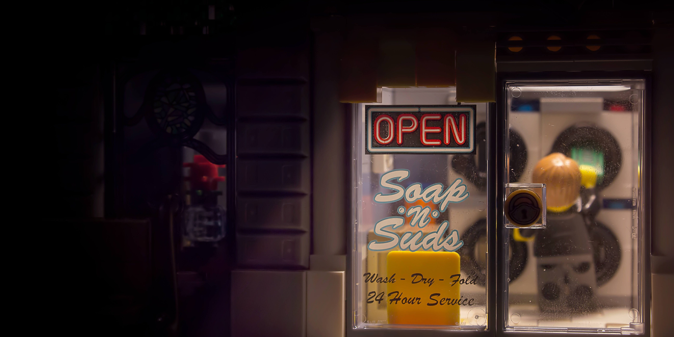
Thank you from all of us at DE’Laundro Services.

